Slide 1
Office Etiquette
Understanding Professional Behavior and Its Importance

Slide 2
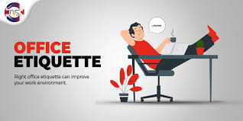
What is Etiquette?
Etiquette refers to a set of rules and norms for polite behavior in society or professional settings. It helps ensure respect, harmony, and effective communication.

Slide 3
Importance of Office Etiquette
• Creates a respectful and professional workplace environment
• Enhances communication and teamwork
• Improves productivity and reduces conflicts
• Reflects positively on individuals and the organization

Slide 4
Types of Office Etiquette
1. Communication Etiquette: Verbal, non-verbal, and written communication.
2. Workspace Etiquette: Cleanliness and respect for shared spaces.
3. Meeting Etiquette: Timeliness, preparation, and attentiveness.
4. Email Etiquette: Professional language and clarity.
5. Diversity Etiquette:Respect for cultural differences.
6. Conflict Resolution Etiquette: Addressing issues privately and constructively.

Slide 5

Communication Etiquette
• Speak clearly and respectfully.
• Use professional language in emails and messages.
• Listen actively and maintain eye contact during conversations.
• Avoid interrupting others while they are speaking.

Slide 6
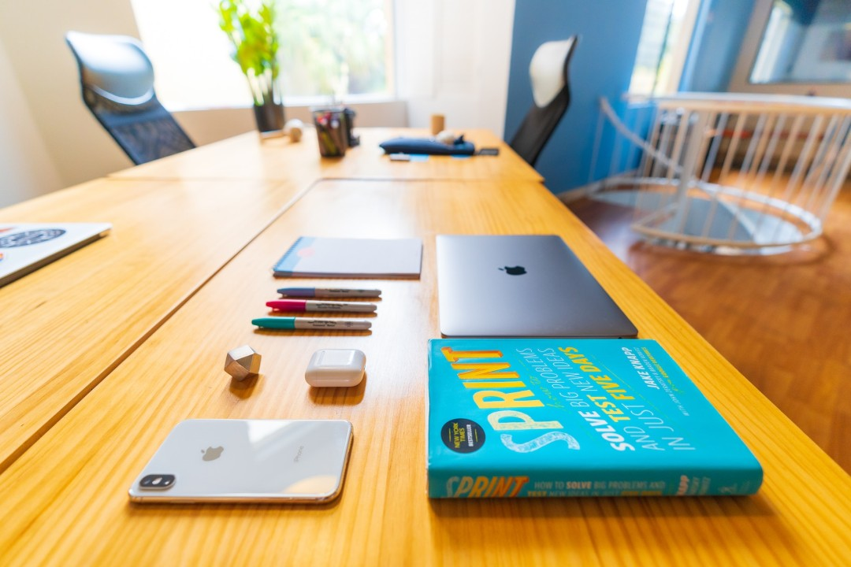
Workspace Etiquette
• Keep your workspace clean and organized.
• Avoid loud noises and unnecessary disruptions.
• Respect shared spaces like kitchens and meeting rooms.

Slide 7

Meeting Etiquette
• Arrive on time and come prepared.
• Follow the agenda and contribute constructively.
• Avoid multitasking or using your phone during meetings.

Slide 8

Mobile Etiquette
• Keep your phone ringtone basic and soft.
• Don’t shout for help.
•Don’t talk on phone while sitting in a work station.
Restrict to official phone call

Slide 9
Conclusion
• Office etiquette fosters professionalism and harmony in the workplace.
• Commit to respectful and polite behavior every day.
• A positive attitude and good manners benefit both individuals and organizations.

Slide 10


